Slide 1
Chapter 3
The Relational Database Model

Slide 2
Learning Objectives
After completing this chapter, you will be able to:
Describe the relational database model’s logical structure
Identify the relational model’s basic components and explain the structure, contents, and characteristics of a relational table
Use relational database operators to manipulate relational table contents
Explain the purpose and components of the data dictionary and system catalog
Identify appropriate entities and then the relationships among the entities in the relational database model
Describe how data redundancy is handled in the relational database model
Explain the purpose of indexing in a relational database

Slide 3
A Logical View of Data
Relational database model enables logical representation of the data and its relationships
Logical simplicity yields simple and effective database design methodologies
The logical view is facilitated by the creation of data relationships based on a logical construct called a relation

Slide 4
Tables and Their Characteristics
Table 3.1 | Characteristics of a Relational Table
1 | A table is perceived as a two-dimensional structure composed of rows and columns.
2 | Each table row (tuple) represents a single entity occurrence within the entity set.
3 | Each table column represents an attribute, and each column has a distinct name.
4 | Each intersection of a row and column represents a single data value.
5 | All values in a column must conform to the same data format.
6 | Each column has a specific range of values known as the attribute domain.
7 | The order of the rows and columns is immaterial to the DBMS.
8 | Each table must have an attribute or combination of attributes that uniquely identifies each row.

Slide 5
Keys
Keys consist of one or more attributes that determine other attributes
Ensure that each row in a table is uniquely identifiable
Establish relationships among tables and to ensure the integrity of the data
Primary key: attribute or combination of attributes that uniquely identifies a row

Slide 6
Dependencies
Determination
State in which knowing the value of one attribute makes it possible to determine the value of another
Establishes the role of a key
Based on the relationships among the attributes
Functional dependence: value of one or more attributes determines the value of one or more other attributes
Determinant: attribute whose value determines another
Dependent: attribute whose value is determined by the other attribute
Full functional dependence: entire collection of attributes in the determinant is necessary for the relationship

Slide 7
Types of Keys (1 of 3)
Several different types of keys are used in the relational model
Composite key: key that is composed of more than one attribute
Key attribute: attribute that is a part of a key
Superkey: key that can uniquely identify any row in the table
Candidate key: minimal superkey
Entity integrity: condition in which each row in the table has its own unique identity
All of the values in the primary key must be unique
No key attribute in the primary key can contain a null
Null: absence of any data value
Unknown attribute value, known but missing attribute value, or inapplicable condition
Referential integrity: every reference to an entity instance by another entity instance is valid
Foreign key: primary key of one table that has been placed into another table to create a common attribute
Secondary key: key used strictly for data retrieval purposes

Slide 8
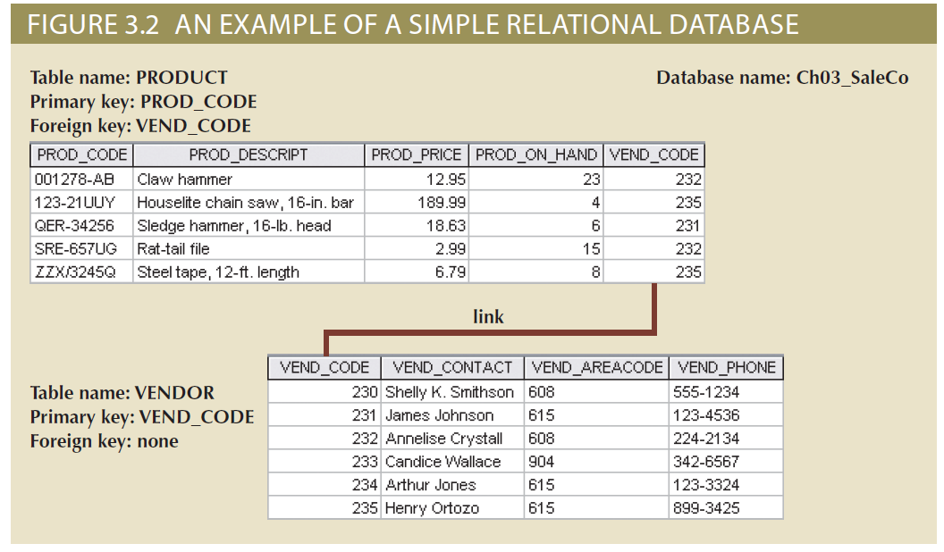
Types of Keys (2 of 3)

Slide 9
Types of Keys (3 of 3)
Table 3.3 | Relational Database Keys
Key Type | Definition
Superkey | An attribute or combination of attributes that uniquely identifies each row in a table.
Candidate key | A minimal (irreducible) superkey; a superkey that does not contain a subset of attributes that is itself a superkey.
Primary key | A candidate key selected to uniquely identify all other attribute values in any given row; cannot contain null entries.
Foreign key | An attribute or combination of attributes in one table whose values must either match the primary key in another table or be null.
Secondary key | An attribute or combination of attributes used strictly for data retrieval purposes.

Slide 10
Integrity Rules (1 of 4)
Relational database integrity rules are very important to good database design
Relational database management systems (RDBMSs) enforce integrity rules automatically
Much safer to make sure the application design conforms to entity and referential integrity rules

Slide 11
Integrity Rules (2 of 4)
Table 3.4 | Integrity Rules
Entity Integrity | Description
Requirement | All primary key entries are unique, and no part of a primary key may be null.
Purpose | Each row will have a unique identity, and foreign key values can properly reference primary key values.
Example | No invoice can have a duplicate number, nor can it be null; in short, all invoices are uniquely identified by their invoice number.
Referential Integrity | Description
Requirement | A foreign key may have either a null entry, as long as it is not a part of its table’s primary key, or an entry that matches the primary key value in a table to which it is related (every non-null foreign key value must reference an existing primary key value).
Purpose | It is possible for an attribute not to have a corresponding value, but it will be impossible to have an invalid entry; the enforcement of the referential integrity rule makes it impossible to delete a row in one table whose primary key has mandatory matching foreign key values in another table.
Example | A customer might not yet have an assigned sales representative (number), but it will be impossible to have an invalid sales representative (number).

Slide 12
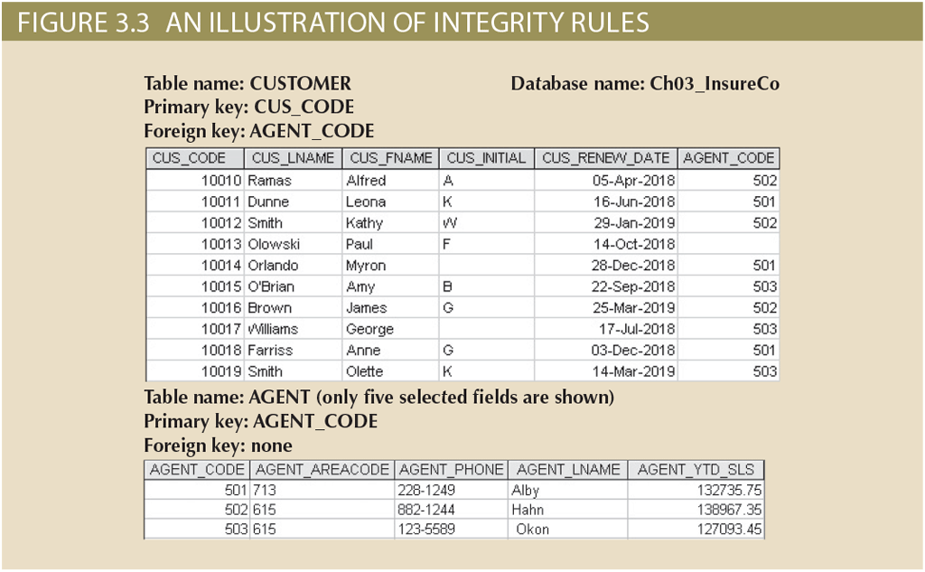
Integrity Rules (3 of 4)

Slide 13
Integrity Rules (4 of 4)
Ways to handle nulls
Flags
Special codes used to indicate the absence of some value
Constraints
NOT NULL constraint: placed on a column to ensure that every row in the table has a value for that column
UNIQUE constraint: restriction placed on a column to ensure that no duplicate values exist for that column

Slide 14
Relational Algebra
Theoretical way of manipulating table contents using relational operators
Relvar: variable that holds a relation
Heading contains the names of the attributes
Body contains the relation
Relational operators have the property of closure
Closure: use of relational algebra operators on existing relations produces new relations

Slide 15
Relational Set Operators (1 of 11)
Select (restrict)
Unary operator that yields a horizontal subset of a table
Project
Unary operator that yields a vertical subset of a table
Union
Combines all rows from two tables, excluding duplicate rows
Union-compatible: tables share the same number of columns, and their corresponding columns share compatible domains
Intersect
Yields only the rows that appear in both tables
Tables must be union-compatible to yield valid results

Slide 16
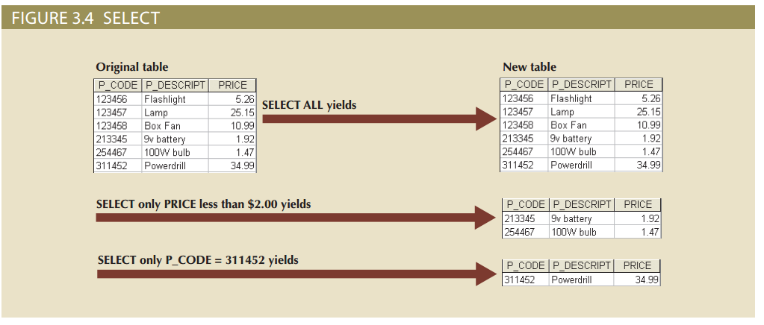
Relational Set Operators (2 of 11)

Slide 17
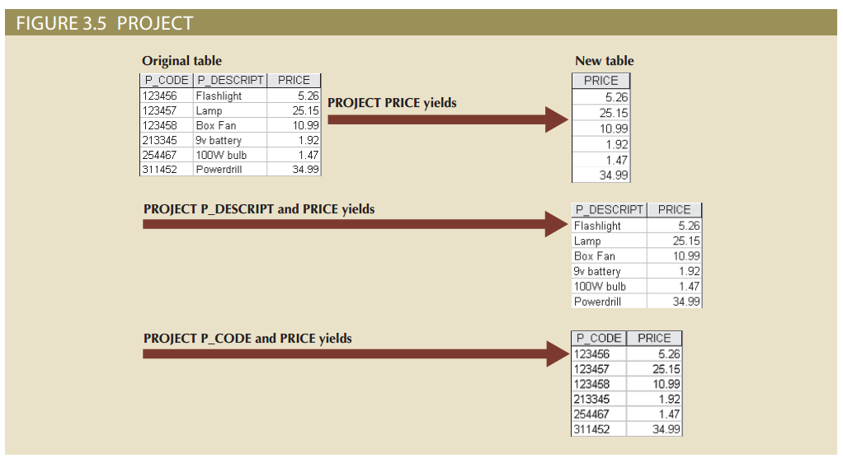
Relational Set Operators (3 of 11)

Slide 18
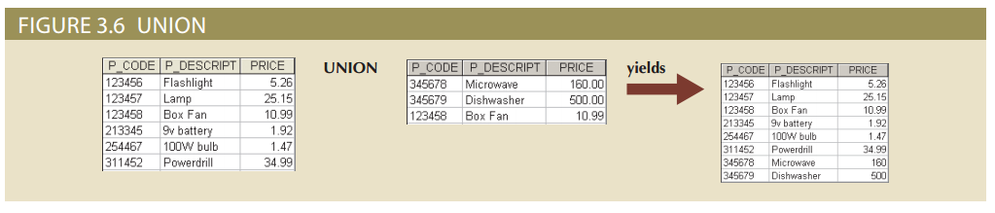
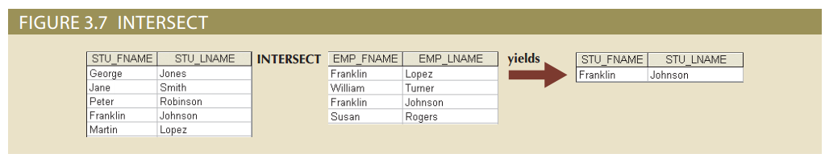
Relational Set Operators (4 of 11)

Slide 19
Relational Set Operators (5 of 11)
Difference
Yields all rows in one table that are not found in the other table
Tables must be union-compatible to yield valid results
Product
Yields all possible pairs of rows from two tables

Slide 20
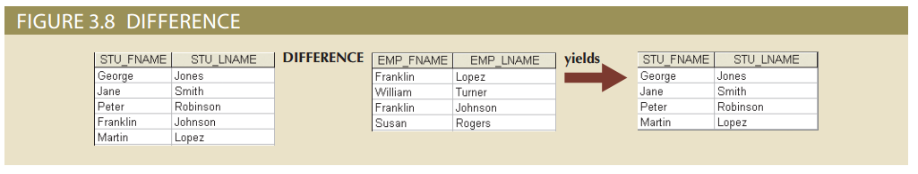
Relational Set Operators (6 of 11)

Slide 21
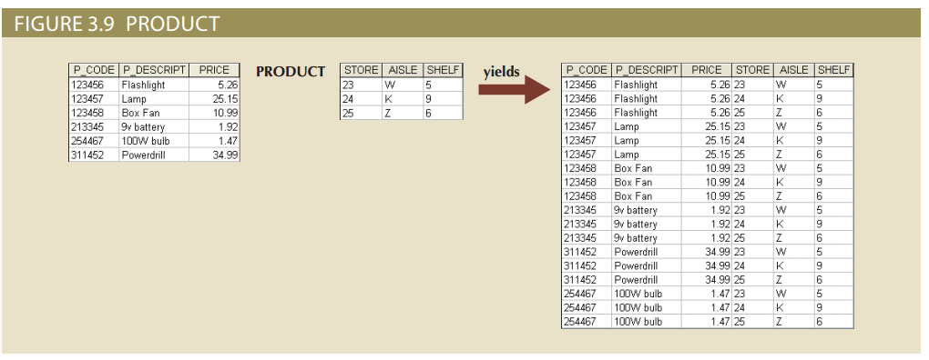
Relational Set Operators (7 of 11)

Slide 22
Relational Set Operators (8 of 11)
Joins allow information to be intelligently combined from two or more tables
Natural join: links tables by selecting only the rows with common values in their common attribute
Equijoin: links tables on the basis of an equality condition that compares specified columns of each table
Theta join: links tables using an inequality comparison operator
Inner join: only returns matched records from the tables that are being joined
Outer join: matched pairs are retained and unmatched values in the other table are left null
Left outer join: yields all of the rows in the first table, including those that do not have a matching value in the second table
Right outer join: yields all of the rows in the second table, including those that do not have matching values in the first table

Slide 23
Relational Set Operators (9 of 11)
Divide
Uses one double-column table as the dividend and one single-column table as the divisor
Output is a single column that contains all values from the second column of the dividend that are associated with every row in the divisor

Slide 24
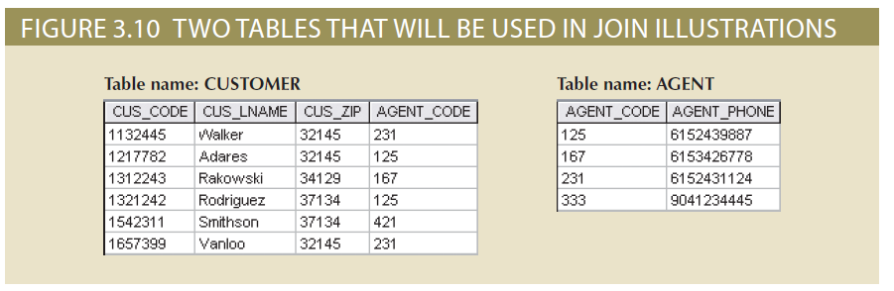
Relational Set Operators (10 of 11)

Slide 25
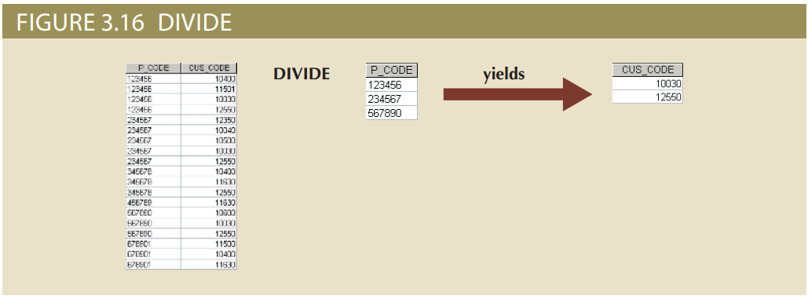
Relational Set Operators (11 of 11)

Slide 26
Data Dictionary and the System Catalog
Data dictionary
Description of all tables in the database created by the user and designer
System catalog
System data dictionary that describes all objects within the database
Homonyms and synonyms must be avoided to lessen confusion
Homonym: same name is used to label different attributes
Synonym: different names are used to describe the same attribute

Slide 27
Relationships within the Relational Database (1 of 4)
One-to-many (1:M)
Norm for relational databases
One-to-one (1:1)
One entity can be related to only one other entity and vice versa
Many-to-many (M:N)
Implemented by creating a new entity in 1:M relationships with the original entities
Composite entity (i.e., bridge or associative entity): helps avoid problems inherent to M:N relationships
Includes the primary keys of tables to be linked

Slide 28
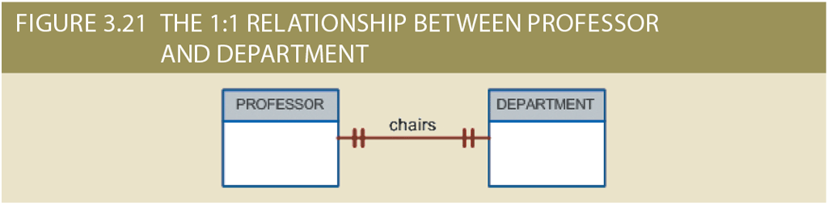
Relationships within the Relational Database (2 of 4)

Slide 29
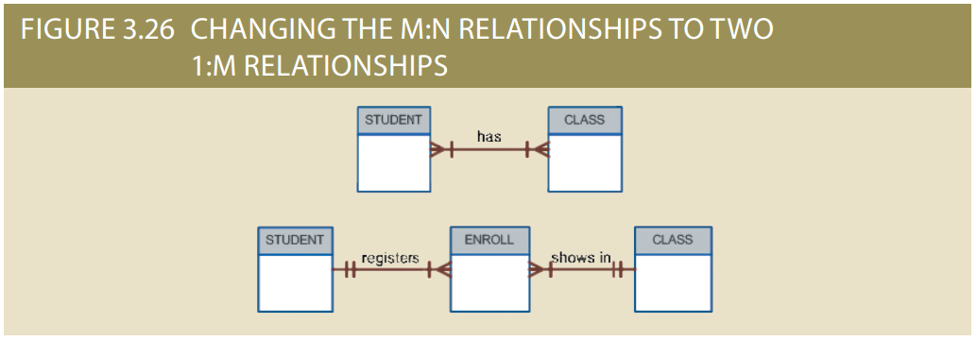
Relationships within the Relational Database (3 of 4)

Slide 30
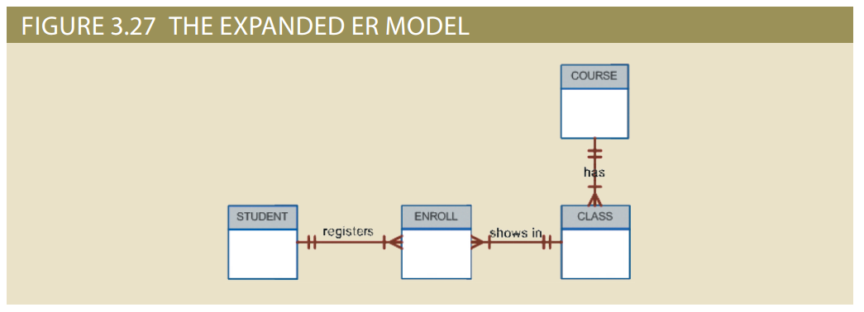
Relationships within the Relational Database (4 of 4)

Slide 31
Data Redundancy Revisited (1 of 2)
The relational database facilitates control of data redundancies through use of foreign keys
Common attributes that are shared by tables
To be controlled except the following circumstances:
Sometimes data redundancy must be increased to make the database serve crucial information purposes
Sometimes data redundancy exists to preserve the historical accuracy of data

Slide 32
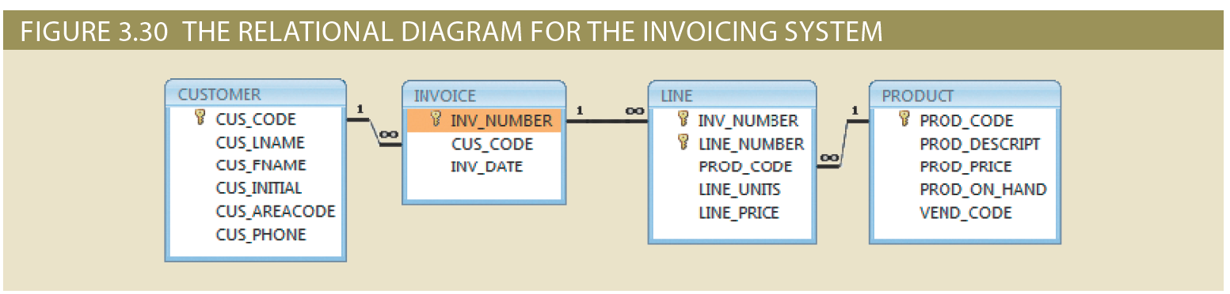
Data Redundancy Revisited (2 of 2)

Slide 33
Indexes
Orderly arrangement to logically access rows in a table
Index key: index’s reference point that leads to data location identified by the key
Unique index: index key can have only one pointer value associated with it
Each index is associated with only one table
The index key can have multiple attributes

Slide 34
Codd’s Relational Database Rules (1 of 2)
Table 13.8 | Dr. Codd’s 12 Relational Database Rules
Rule | Rule Name | Description
1 | Information | All information in a relational database must be logically represented as column values in rows within tables.
2 | Guaranteed access | Every value in a table is guaranteed to be accessible through a combination of table name, primary key value, and column name.
3 | Systematic treatment of nulls | Nulls must be represented and treated in a systematic way, independent of data type.
4 | Dynamic online catalog based on the relational model | The metadata must be stored and managed as ordinary data—that is, in tables within the database; such data must be available to authorized users using the standard database relational language.
5 | Comprehensive data sublanguage | The relational database may support many languages; however, it must support one well-defined, declarative language as well as data definition, view definition, data manipulation (interactive and by program), integrity constraints, authorization, and transaction management (begin, commit, and rollback).
6 | View updating | Any view that is theoretically updatable must be updatable through the system.
7 | High-level insert, update, and delete | The database must support set-level inserts, updates, and deletes.

Slide 35
Codd’s Relational Database Rules (2 of 2)
Table 13.8 | Dr. Codd’s 12 Relational Database Rules
Rule | Rule Name | Description
8 | Physical data independence | Application programs and ad hoc facilities are logically unaffected when physical access methods or storage structures are changed.
9 | Logical data independence | Application programs and ad hoc facilities are logically unaffected when changes are made to the table structures that preserve the original table values (changing order of columns or inserting columns).
10 | Integrity independence | All relational integrity constraints must be definable in the relational language and stored in the system catalog, not at the application level.
11 | Distribution independence | The end users and application programs are unaware of and unaffected by the data location (distributed vs. local databases).
12 | Nonsubversion | If the system supports low-level access to the data, users must not be allowed to bypass the integrity rules of the database.
13 | Rule zero | All preceding rules are based on the notion that to be considered relational, a database must use its relational facilities exclusively for management.

Slide 36
Summary
Tables are the basic building blocks of a relational database
Keys are central to the use of relational tables
Each table row must have a primary key
Although tables are independent, they can be linked by common attributes
The relational model supports several relational algebra functions
A relational database performs much of the data manipulation work behind the scenes
Once you know the basics of relational databases, you can concentrate on design

